Slide 1

ScoutIQ
Team Venus
Samiha Sharma, Ishika Narang, Jasper Henrici, Georgi Backhaus, Tamás Vitos
Driven by data. Not by noise.
Notes:
Hi, I'm from Sports IQ - we're a football analytics consultancy that turns data into winning strategies.

Slide 2
THE VISION
COMPANY NAME
AGENDA
01
(scenario set up)
02
(vision, data sources, approaches)
03
(visualisations - ex of one past team)
04
(demo)
05
(conclusions)
06
(next steps + takeaways)
Notes:
Title these slides = and keep consistent with following slides

Slide 3
Every transfer,
every decision,
every move -
powered by intelligence, not instinct.
THE VISION
Notes:
SportsIQ: Where data beats hype. We deliver performance insights that power smarter football decisions.
None of this would be possible without the people behind it. So here’s my team — the minds driving SportsIQ forward.

Slide 4
OUR OBJECTIVES
Quantify player performance
Simplify decision-making
Enhance recruitment agency
Convert player metrics into comparable insights
Deliver clear visuals into comparable insights
Match teams with best-fit players faster
Defensive reliability
Penalty performance overview
Key passes
Expected performance
Using percentiles and per 90 stats
Radar plots
Scatter plots
Market value measurement
Performance ↔ Market value - Opportunity tracking
Scout high performance players
Find similar top-performers
Notes:
“To bring that vision to life, we focused on three clear objectives:
First, quantify performance, by (read examples…)
Second, simplify decision-making, using visuals that anyone — from scouts to directors — can understand.
And third, enhance recruitment accuracy, by finding not just good players, but the right players.”

Slide 5

APPROACH
Build line plots, scatterplots, spider charts, and heatmaps to reveal performance trends.
Pull player performance, market & contextual data via credible sport APIs
Exploration & Visualization
Data Collection
Handle noise, normalize per 90s, structure multi-position players.
Player market value by league & year, Position-specific stats
Identify best-fit and similar players for specific team needs.
Preprocessing & Cleaning
Player Insights
Pitch and recommend player(s) to client team
Analytics & Feature Engineering
Recommendation
Notes:
“Our approach follows a simple five-step pipeline.
We started with data collection, pulling performance, market, and contextual data from reliable APIs.
Then came preprocessing to make fair comparisons— cleaning missing values, normalizing everything per 90 minutes, and exploding the data to account for players who play multiple positions
We engineered features like expected assists, progressive passes, and shot-creating actions, as well as mapping out a players million-euro market value.
Then we measured players positional success through complex scatter plots, spider graphs, heatmaps and market value trends to reveal standout players.
And finally, we discovered our star players and their close second which we turned into actionable recommendations for clubs.”

Slide 6



DATA SOURCES
Together, these APIs give us a 360° view of player quality, efficiency, and market value.
FBref
TransferMarkt
Understat API
Type →
Match & player performance metrics
Type →
Market value & player info
Type →
Expected-goals models & advanced stats
Value →
Deep technical coverage (passes, pressures, tackles) across major leagues.
Value →
Adds financial context — market worth, contract, age, nationality.
Value →
Trusted analytics backbone for attacking/defensive efficiency.
https://fbref.com/en/
UnderstatUnderstathttps://understat.com
https://www.transfermarkt.de/
Notes:
Isha - include source links
“We used three major sources that complement each other perfectly.
FBref, powered by StatsBomb data, gives detailed match and player metrics across top leagues.
Understat provides expected goals and advanced stats — the core of modern performance analysis.
And Transfermarkt brings in market value, contracts, and age data
Together, they give us a full 360-degree view of every player — performance, efficiency, and value.”

Slide 7
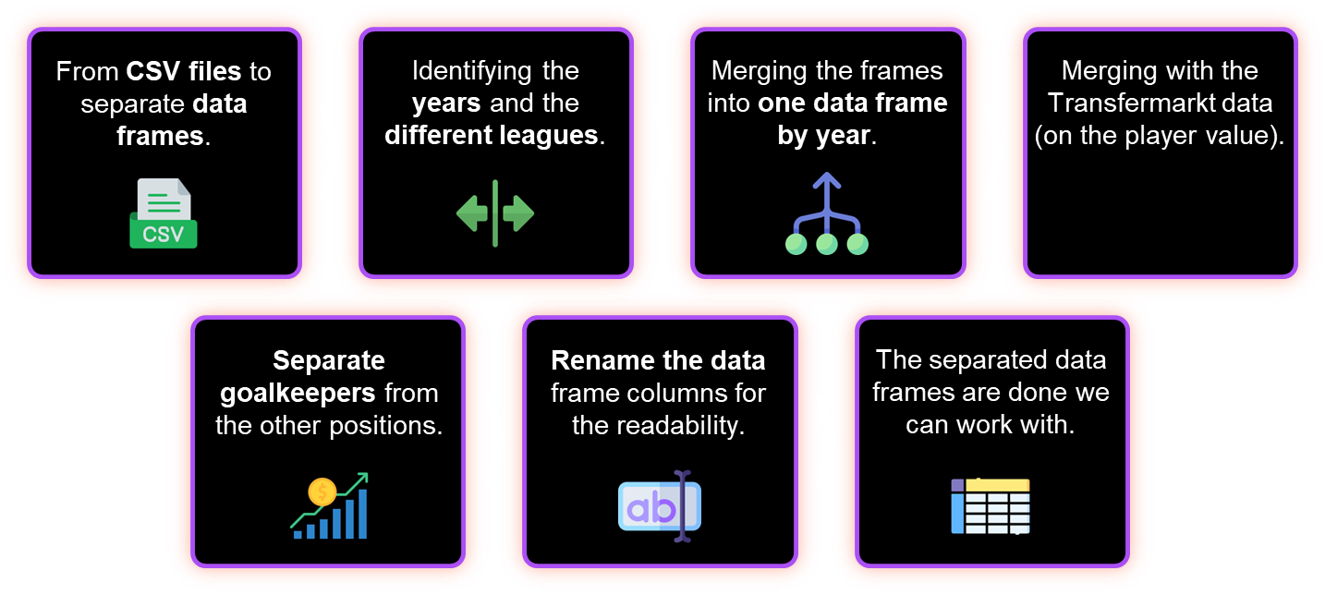
DATA PREPROCESSING
Flowchart about how we arrived from raw data to data frames what we can analyse
Notes:
Tamas

Slide 8
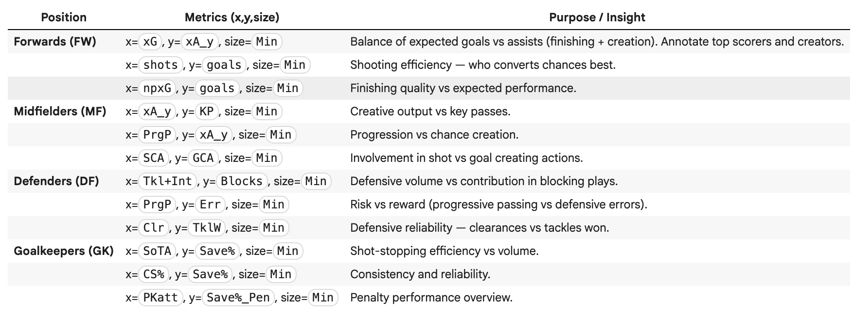
METRICS FOR EACH POSITION

Slide 9
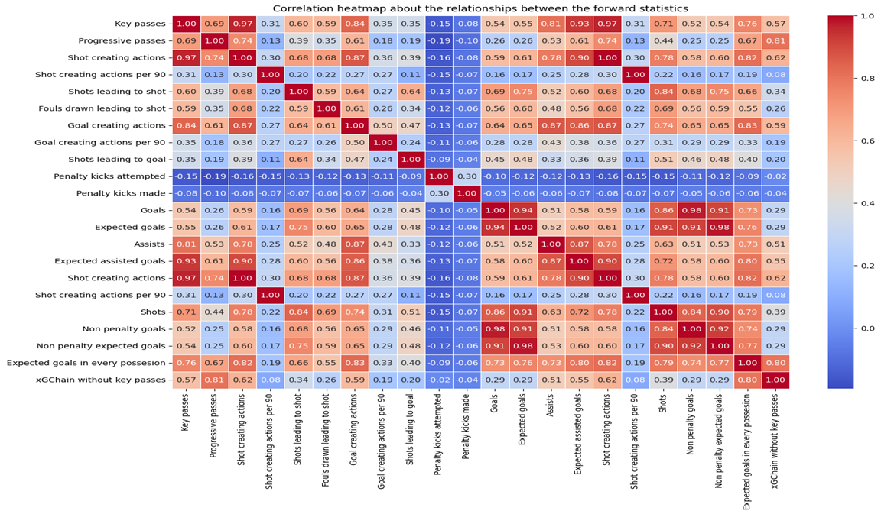
Inter-metric relationships (Forwards)
Notes:
Tamas

Slide 10
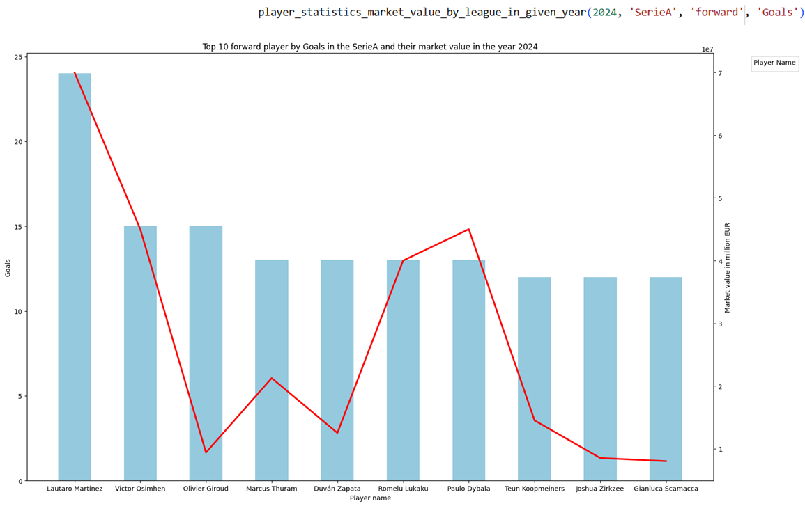
MARKET VALUE BY LEAGUE
Notes:
Tamas

Slide 11
Finding a Replacement for an Injured Forward
Past Project
Notes:
ISHA SUGGESTION: Case Study | West Ham: Replacing a key striker
Problem: Their top striker transferred mid-season.
Goal: Identify affordable replacements with similar output.
Our role: Deliver a shortlist using data-driven profiling.

Slide 12

Bayern Munich ↔ Forward (FW)
Luis Díaz
Ademola Lookman
Kaoru Mitoma
Mohamed Salah
Leroy Sané
Metrics per percentile
Expected goals
94.8
95.9
90.9
99.8
97.8
Non-penalty goals
96.5
97.1
93.1
99.6
94.6
Goals
95.5
96.8
90.5
100
96.4
Assists
88.9
88.8
83.1
100
89.3
Expected goals
Buildup
97.9
94.8
95.1
99.8
95.8
Notes:
Use images;
ISHA SUGGESTION:
Position: Forward (Striker)
Priority Metrics: xG, xA, SCA, GCA, Shot accuracy %
Preferences: Age < 27 | Top-5 League | High minutes played | Market Value < €40 M

Slide 13
RECOMMENDATION
TOP CHOICE
ALTERNATIVES
MARKET VALUE
Díaz
Lookman
€ 70 M
Notes:
Insert images

Slide 14

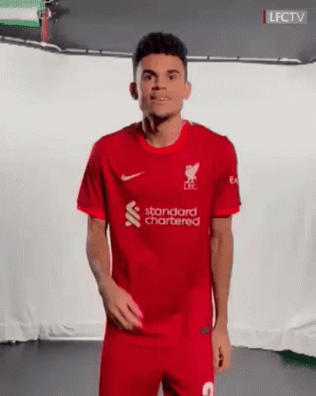
Bayern Munich

Slide 15
Let’s find your next player
A live scouting challenge — tell us your team, position, and priorities.
Notes:
Gosha - Pull up python code

Slide 16
THE VISION
(Explain visualisation pulled up)
Notes:
Isha - explain the scatter plot

Slide 17


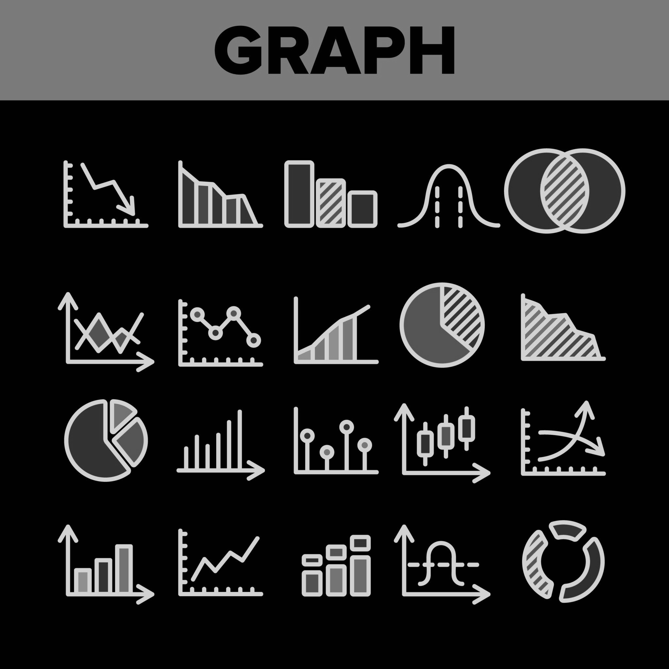
CONCLUSIONS
Data
clarifies
decisions
Evidence
wins
matches
Visuals
simplify
complexity
Data → turns subjectivity → strategy
Evidence → powers data-driven calls
Visuals → bridge analysts & scouts
Notes:
This demo is exactly how we imagine ScoutIQ being used by real clubs.
Data clarifies decisions — turns subjectivity → strategy.
Visuals simplify complexity — bridging analysts and scouts.
Evidence wins matches — smart clubs make data-driven calls.

Slide 18
GROWTH AREAS
Expansion to women’s leagues
a
Potential market share
Interactive Dashboards for clubs & agents
Current market share
Predictive modelling - projecting player growth
Notes:
“Looking ahead, we plan to expand Venus in three directions:

Slide 19
CONCLUSION
COMPANY NAME
THANK YOU
Any questions?

